Slide 1


HOME SECURITY SYSTEM WITH GSM
Team Leader:
YASWANTH K M - 19BEC4237
Team Members: GUIDED BY:
SATHEESHKUMAR N - 19BEC4185 Dr.C.NANDHAGOPAL
SATHISHKUMAR S B - 19BEC4188 AP/ECE.
VISHNURAM T - 19BEC4236

Slide 2
ABSTRACT
In this paper passive Infrared sensor “PIR” based security system is introduced. With this sensor we can save power, and effective management at low cost and requires small memory space.
The PIR sensor is responsible for detecting the change in infrared radiation levels when an intruder or human is passed through the system or space where it is arranged.
Depending on the change in radiation levels the change in voltages occurs and then with this voltage the signal is amplified and hence the sound will be produced. Thus it is helpful in various applications and areas .
This type of system has many advantages compared to the existing system.

Slide 3
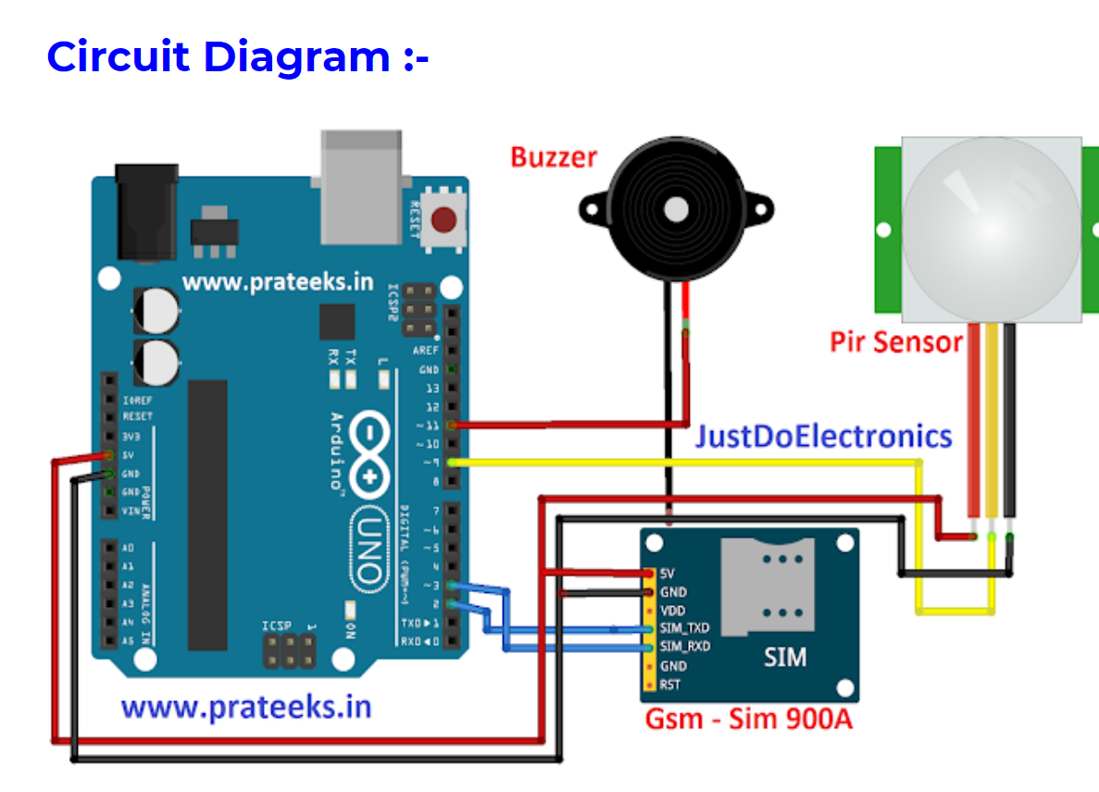
BLOCK DIAGRAM (or) CIRCUIT DIAGRAM

Slide 4
EXPLANATION
A GSM home alarm system is a wireless home security product. The security alarm itself, as well as its motion sensors and door and window opening sensors, link up to a mobile network. Basically, your GSM home security alarm will communicate with the wider GSM network using a SIM card.
PIR sensor is the short form of passive Infrared sensor. The main ideology is to provide security. This is based on PIR sensor with an IC that produces siren or buzzer sound. The PIR sensor detects the IR radiation which is emitted from the humans and then it produces a digital output. Mostly it is used in motion detectors, security alarms, and automatic lighting applications. In general they detect movement i.e. changes the amount of infrared radiation. In turn this digital output is given to the Arduino Uno. after getting digital signal from the PIR sensor, the Arduino UNO then triggers the UM3561 siren. Thus it produces the sound when only human is detected. The UM3561 is a ROM IC. It is used to generate ambulance siren, machine gun sound, fire engine siren, police sounds etc.

Slide 5
ADVANTAGES
Provide the ability to monitor the activities happening on your property when you are away.
Main Advantage of the project is to reduce the aspects of some other robbery.
Improve the home as well as protected without using high Wages.
It is easy to control.
Save Electricity.

Slide 6
PATENT PROCESS

Slide 7
THANK YOU

